Slide 1





Towards the Next Generation of
News Recommenders: The Table d’hôte Approach
Himan Abdollahpouri, Edward C. Malthouse, Joseph A. Konstan, Bamshad Mobasher, Jeremy Gilbert

Slide 2
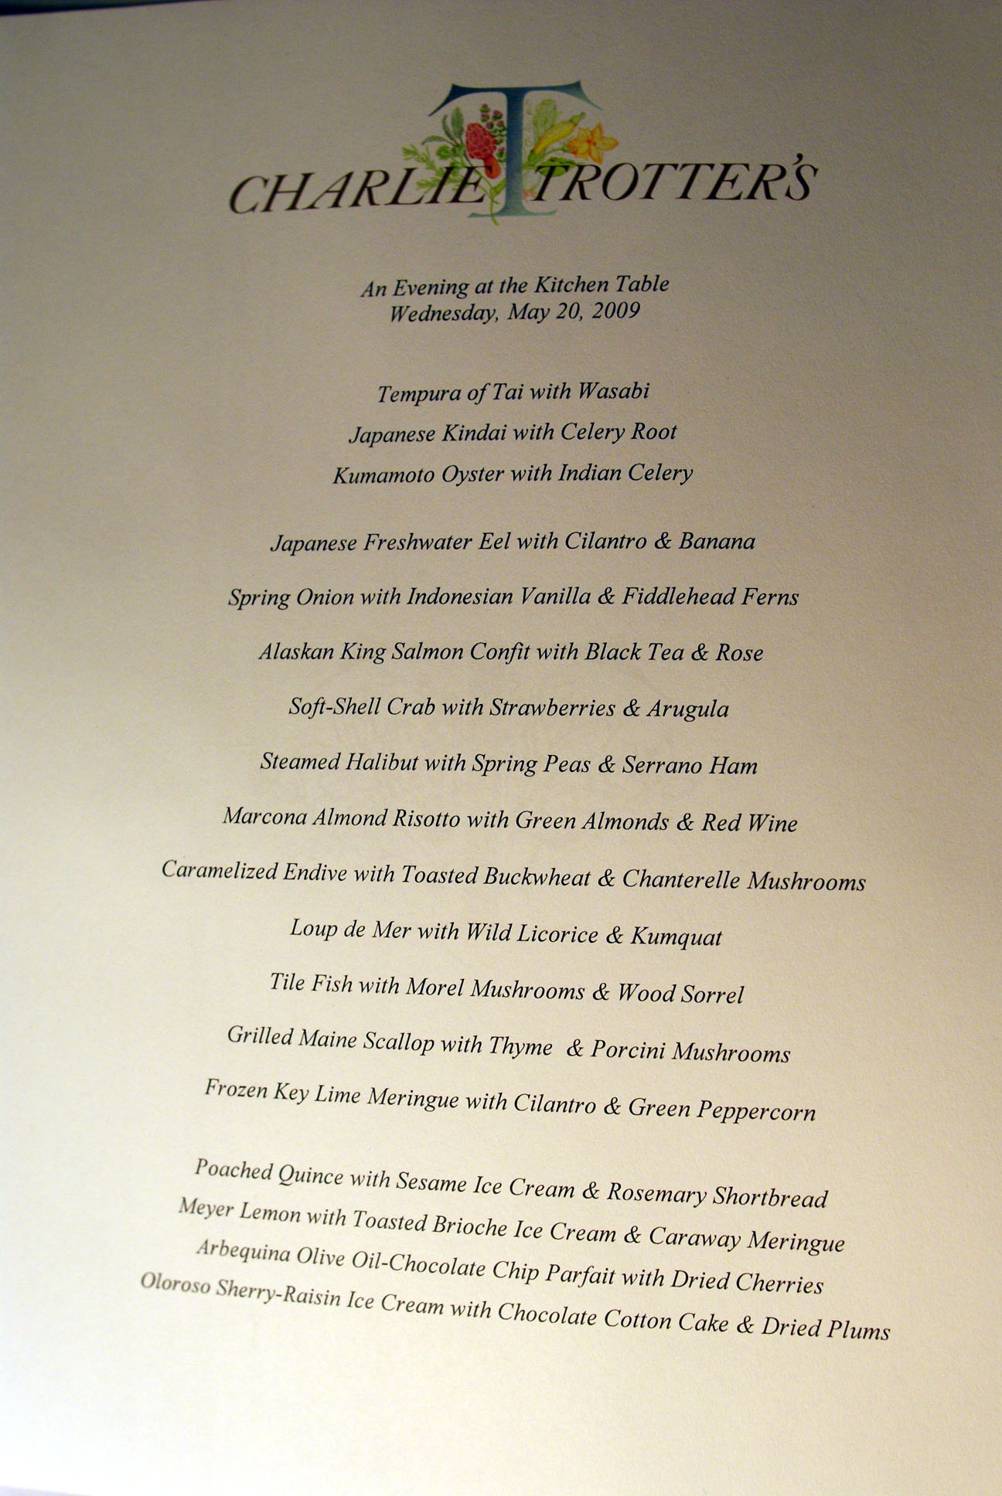

Slide 3




Sequence matters
A
B

Slide 4
Surprise and Serendipity
Amuse bouche =
”amuses the mouth”

Slide 5
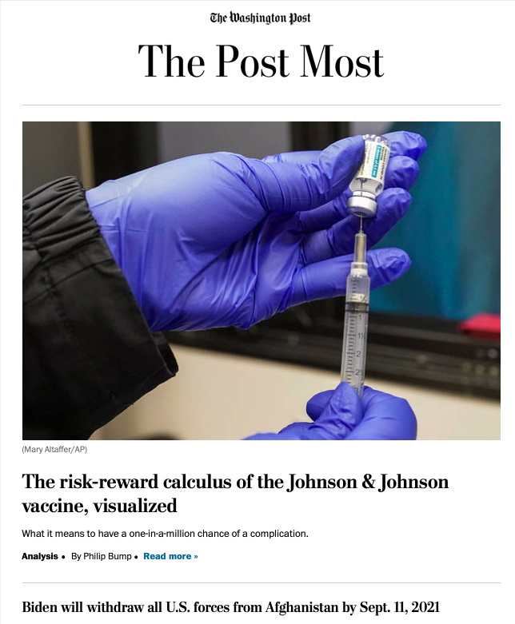
Table d’hôte News Recommender
Articles cover what user needs to know (surveillance)
Unexpected, surprise articles mixed in (news serendipity)
Diversity and balance
Order and sequencing matter
Carefully curated to avoid information overload

Slide 6


User Profile
Available Articles
Surveillance
Personalized ?
Stratify
Personalized
Surveillance
Non-Personalized
Surveillance
Serendipity
Composition
Order
Newsletter

Slide 7
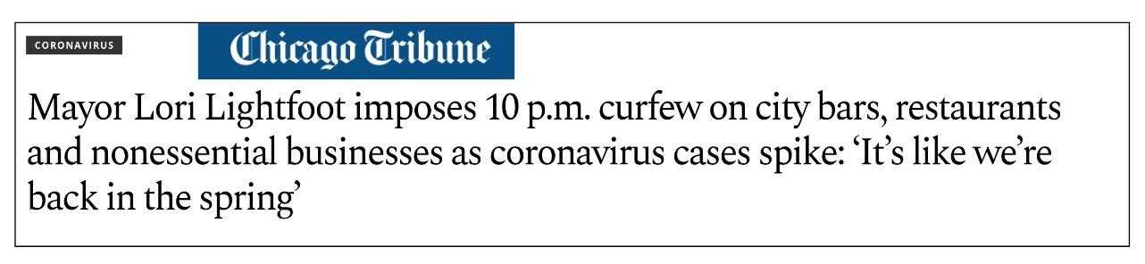


Surveillance Articles
(need to know)
Non-personalized
Personalized

Slide 8
User Profile
Available Articles
Surveillance
Personalized ?
Stratify
Personalized
Surveillance
Non-Personalized
Surveillance
Serendipity
Composition
Order
Newsletter

Slide 9


Serendipity Articles
(bring joy and surprise)
Talkers
Feel good
Utilitarian
Images that wow, interactive visuals
Entertainment/diversion
Timeouts
Media transportation

Slide 10
User Profile
Available Articles
Surveillance
Personalized ?
Stratify
Personalized
Surveillance
Non-Personalized
Surveillance
Serendipity
Composition
Order
Newsletter

Slide 11

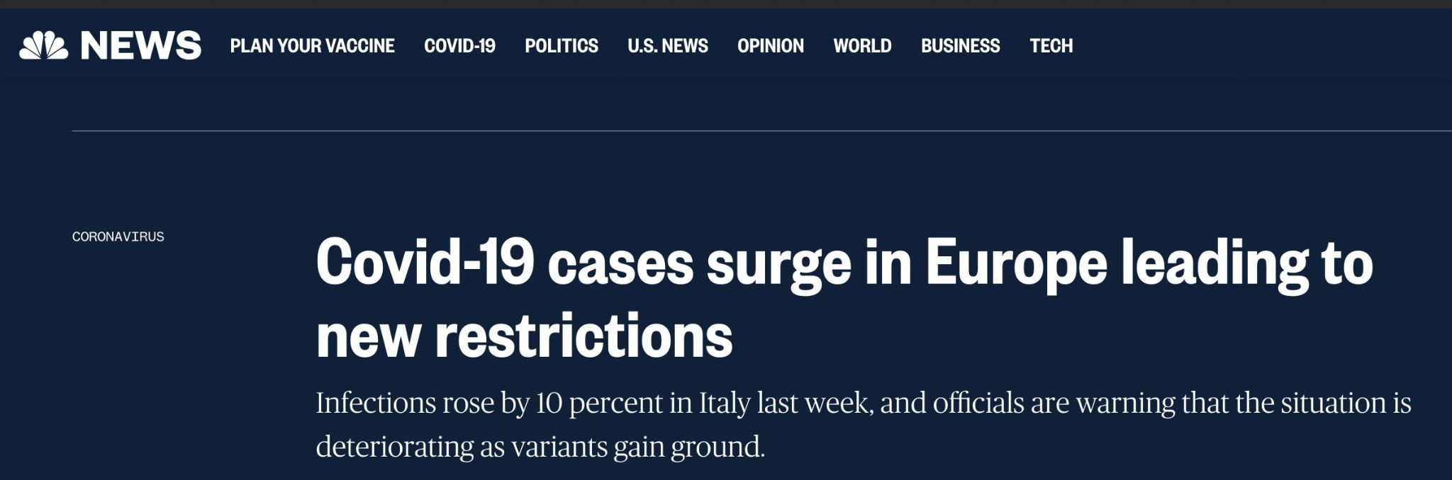
Importance of Sequencing
News that may contradict someone’s beliefs.
We should build the reader’s trust fist and then show that particular news.

Slide 12
Research Questions
How to stratify?
Composition
Presentation
Sequencing
Effectiveness

